Slide 1

CHAPTER 5
SEQUENCES,
MATHEMATICAL
INDUCTION, AND
RECURSION
Copyright © Cengage Learning. All rights reserved.

Slide 2
SECTION 5.1
Sequences
Copyright © Cengage Learning. All rights reserved.

Slide 3
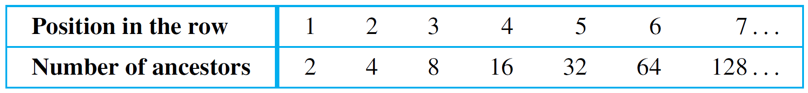
Sequences
Imagine that a person decides to count his ancestors. He has two parents, four grandparents, eight great- grandparents, and so forth, These numbers can be written in a row as
2, 4, 8, 16, 32, 64, 128,…
The symbol “…” is called an ellipsis. It is shorthand for “and so forth.”
To express the pattern of the numbers, suppose that each is labeled by an integer giving its position in the row.

Slide 4
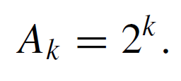
Sequences
The number corresponding to position 1 is 2, which equals 2¹. The number corresponding to position 2 is 4, which equals 2².
For positions 3, 4, 5, 6, and 7, the corresponding numbers are 8, 16, 32, 64, and 128, which equal 2³, 2⁴, 2⁵, 2⁶, and 2⁷, respectively.
For a general value of k, let A_{k} be the number of ancestors in the kth generation back. The pattern of computed values strongly suggests the following for each k:

Slide 5
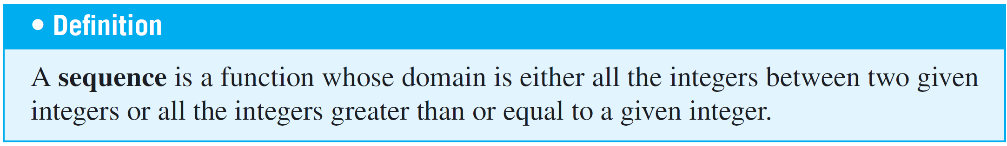

Sequences
We typically represent a sequence as a set of elements written in a row. In the sequence denoted
each individual element a_{k} (read “a sub k”) is called a term.

Slide 6

Sequences
The k in a_{k} is called a subscript or index, m (which may be any integer) is the subscript of the initial term, and n (which must be greater than or equal to m) is the subscript of the final term. The notation
denotes an infinite sequence. An explicit formula or general formula for a sequence is a rule that shows how the values of a_{k} depend on k.
The following example shows that it is possible for two different formulas to give sequences with the same terms.

Slide 7
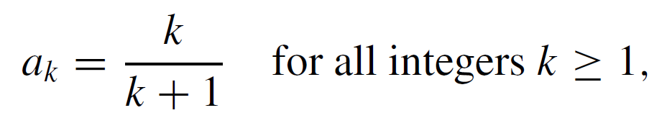
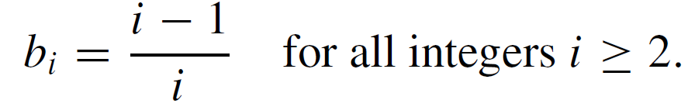
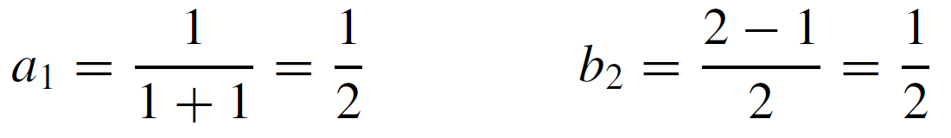
Example 1 – Finding Terms of Sequences Given by Explicit Formulas
Define sequences a₁, a₂, a₃,… and b₂, b₃, b₄,… by the following explicit formulas:
Compute the first five terms of both sequences.
Solution:

Slide 8
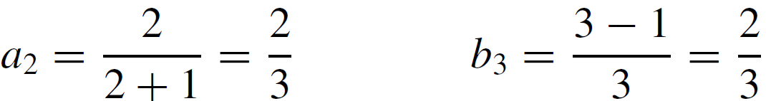
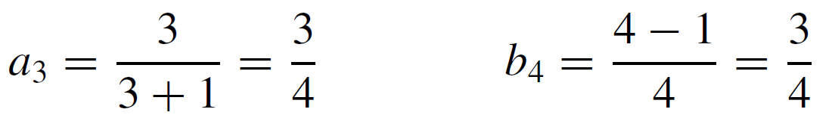
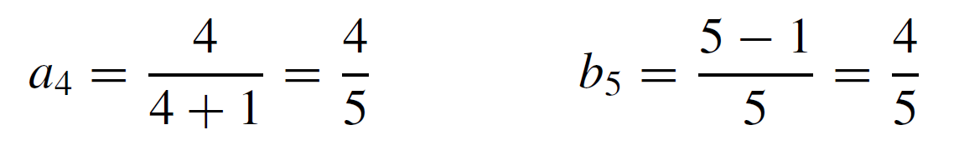
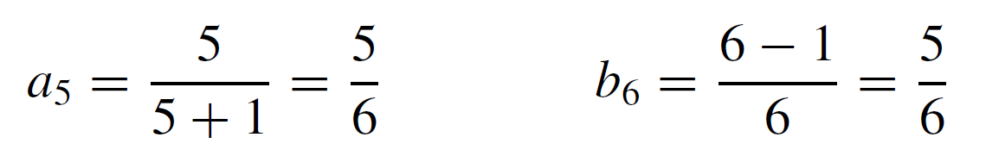
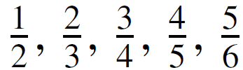
Example 1 – Solution
cont’d
As you can see, the first terms of both sequences are
;; in fact, it can be shown that all terms of both sequences are identical.

Slide 9
Summation Notation

Slide 10
Summation Notation
Consider again the example in which A_{k} = 2^{k} represents the number of ancestors a person has in the kth generation back. What is the total number of ancestors for the past six generations?
The answer is
It is convenient to use a shorthand notation to write such
sums.

Slide 11
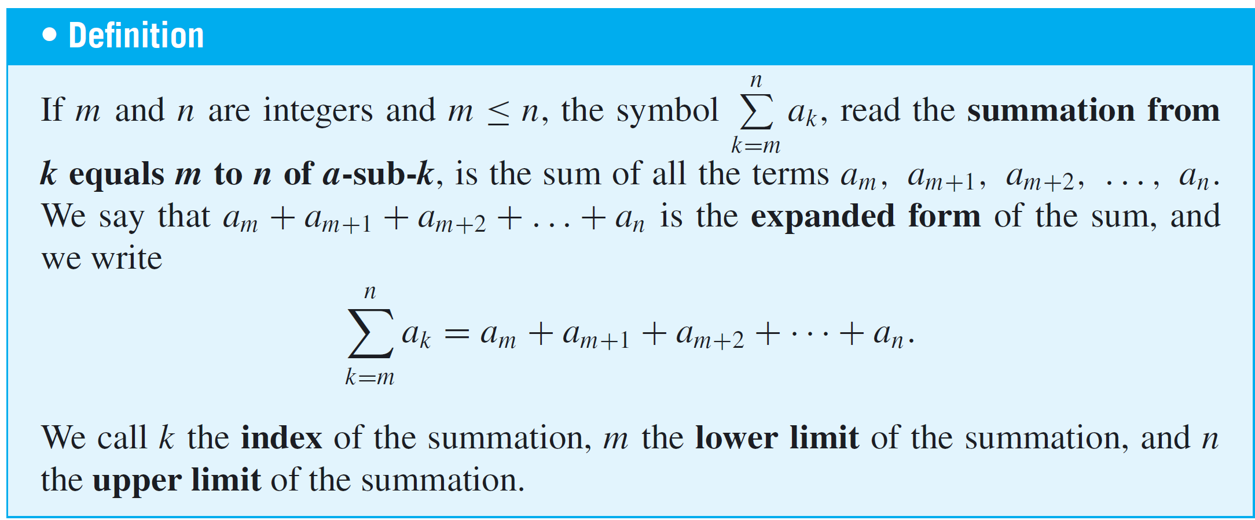
Summation Notation
In 1772 the French mathematician Joseph Louis Lagrange introduced the capital Greek letter sigma, Σ, to denote the word sum (or summation), and defined the summation notation as follows:

Slide 12
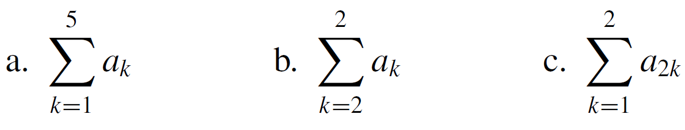
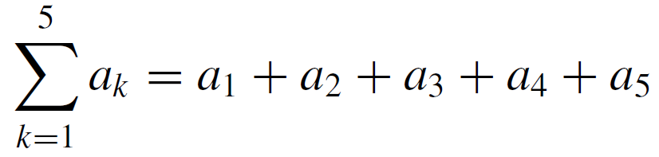
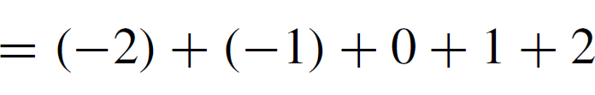

Example 4 – Computing Summations
Let a₁ = −2, a₂ = −1, a₃ = 0, a₄ = 1, and a₅ = 2. Compute the following:
a. b. c.
Solution:
a.

Slide 13
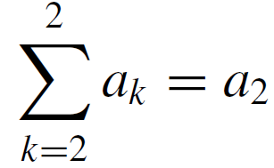

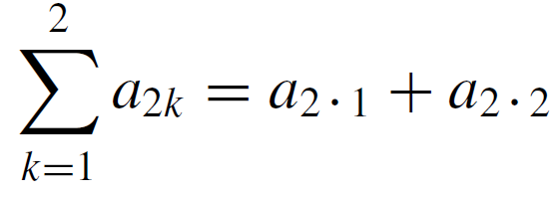
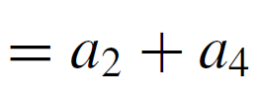
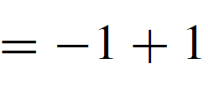
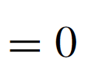
Example 4 – Solution
cont’d
b.
c.

Slide 14
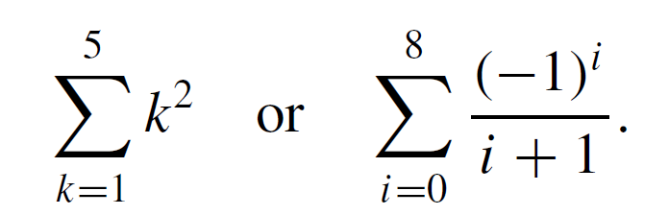
Summation Notation
Oftentimes, the terms of a summation are expressed using an explicit formula.
For instance, it is common to see summations such as

Slide 15
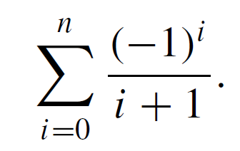
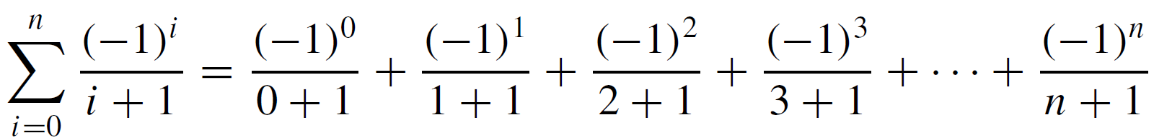
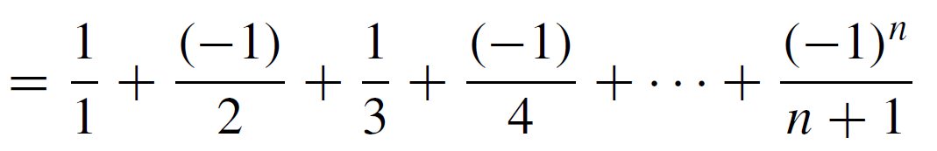
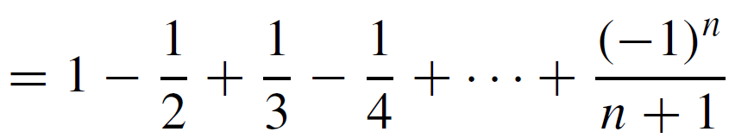
Example 6 – Changing from Summation Notation to Expanded Form
Write the following summation in expanded form:
Solution:

Slide 16
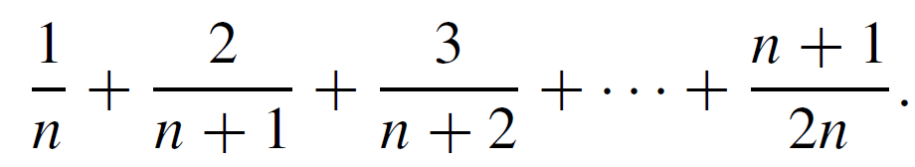
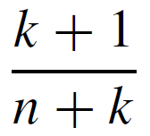
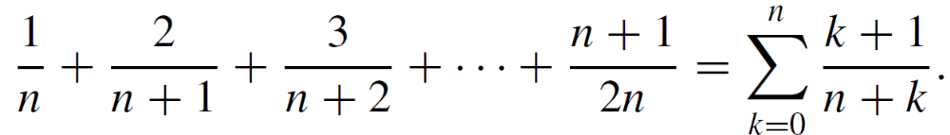
Example 7 – Changing from Expanded Form to Summation Notation
Express the following using summation notation:
Solution:
The general term of this summation can be expressed as for integers k from 0 to n.
Hence

Slide 17
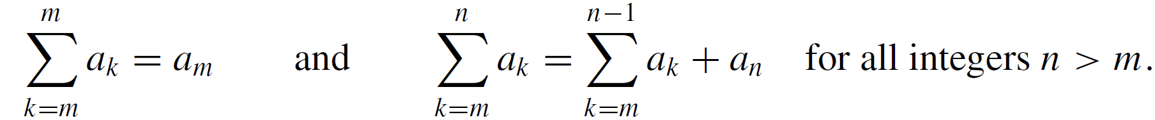
Summation Notation
A more mathematically precise definition of summation, called a recursive definition, is the following:
If m is any integer, then
When solving problems, it is often useful to rewrite a summation using the recursive form of the definition, either by separating off the final term of a summation or by adding a final term to a summation.

Slide 18
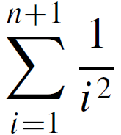
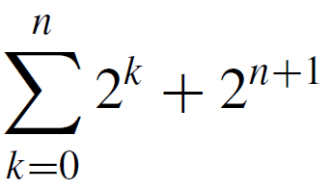
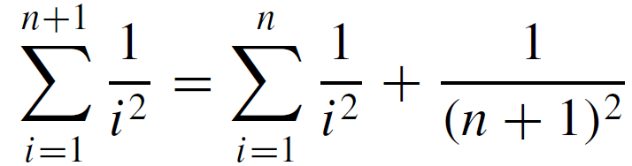
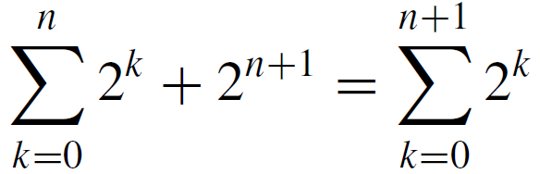
Example 9 – Separating Off a Final Term and Adding On a Final Term
a. Rewrite by separating off the final term.
b. Write as a single summation.
Solution:
a.
b.

Slide 19
Summation Notation
In certain sums each term is a difference of two quantities.
When you write such sums in expanded form, you sometimes see that all the terms cancel except the first and the last.
Successive cancellation of terms collapses the sum like a telescope.

Slide 20
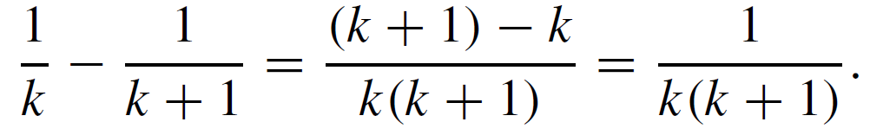
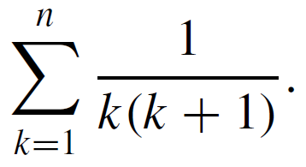
Example 10 – A Telescoping Sum
Some sums can be transformed into telescoping sums, which then can be rewritten as a simple expression.
For instance, observe that
Use this identity to find a simple expression for

Slide 21
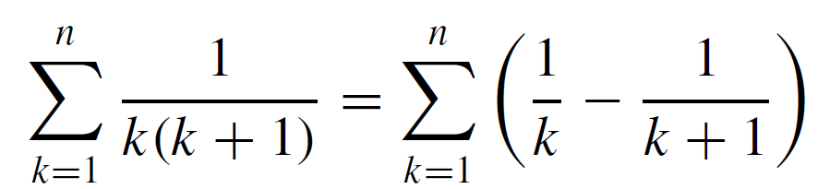
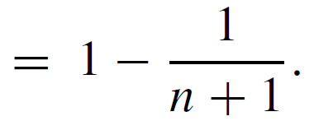
Example 10 – Solution

Slide 22
Product Notation

Slide 23

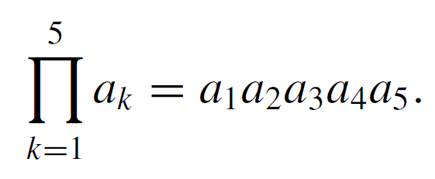
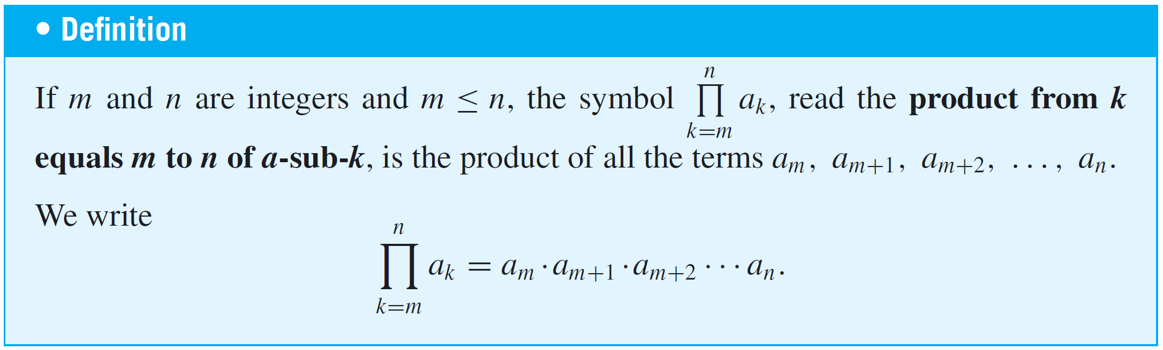
Product Notation
The notation for the product of a sequence of numbers is analogous to the notation for their sum. The Greek capital letter pi, , denotes a product. For example,

Slide 24
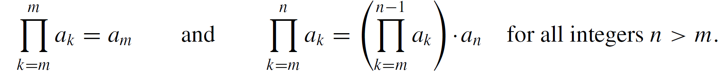
Product Notation
A recursive definition for the product notation is the following: If m is any integer, then

Slide 25
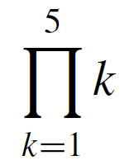
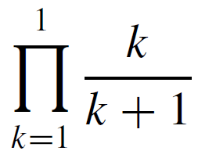
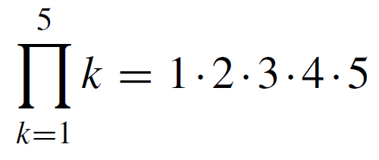
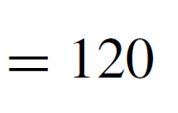
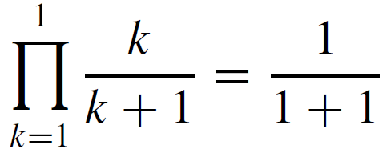
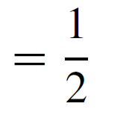
Example 11 – Computing Products
Compute the following products:
a.
b.
Solution:
a.
b.

Slide 26
Properties of Summations
and Products

Slide 27
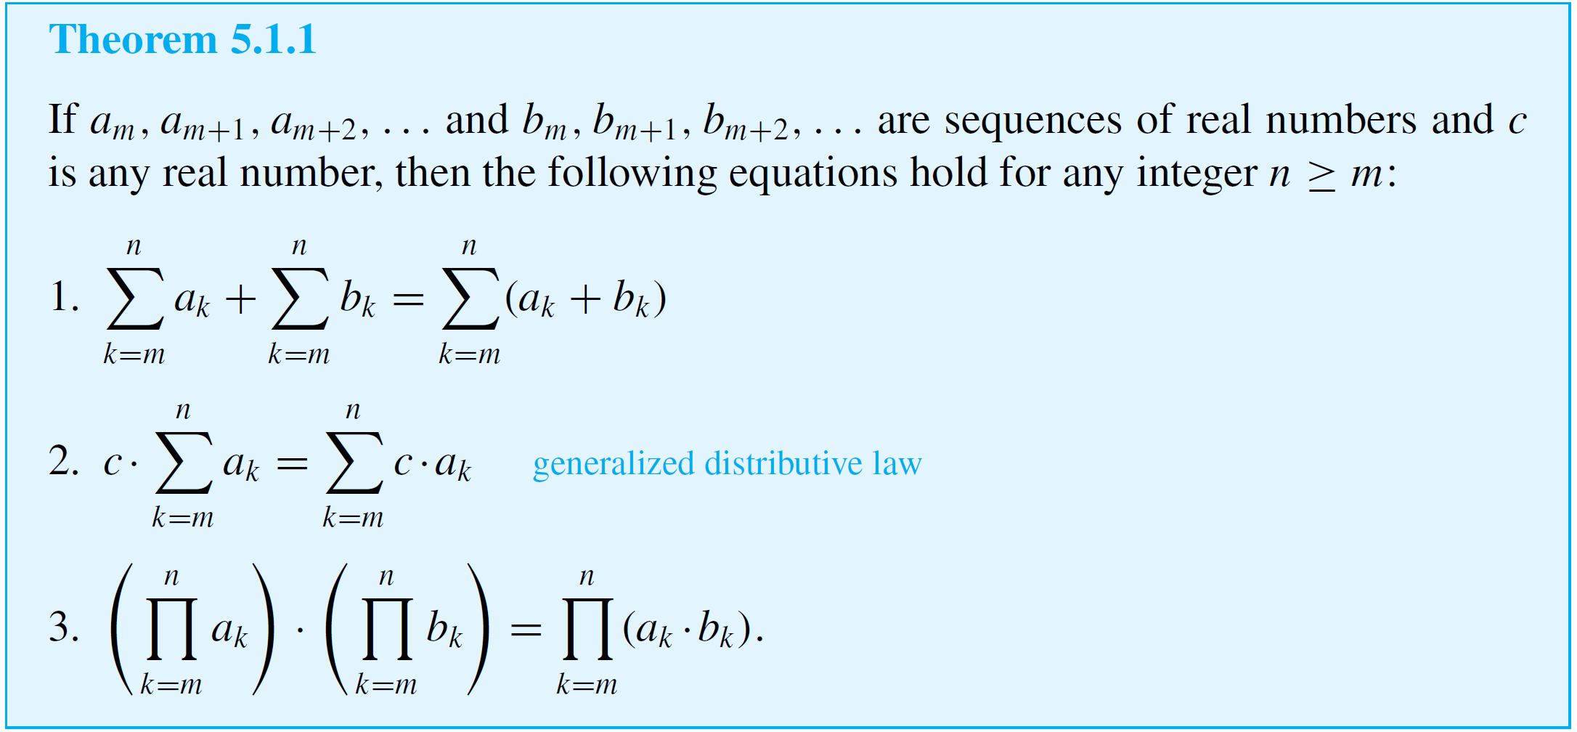
Properties of Summations and Products
The following theorem states general properties of summations and products.

Slide 28
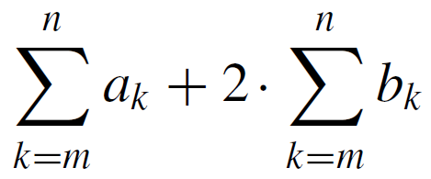
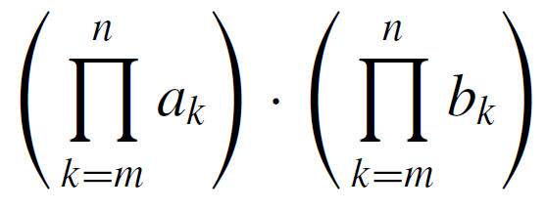
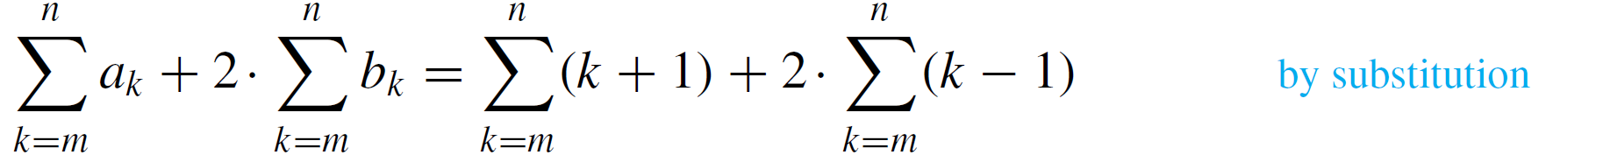

Example 12 – Using Properties of Summation and Product
Let a_{k} = k + 1 and b_{k} = k − 1 for all integers k. Write each of the following expressions as a single summation or product:
a. b.
Solution:
a.

Slide 29





Example 12 – Using Properties of Summation and Product
b.

Slide 30
Change of Variable

Slide 31



Change of Variable
Observe that
and also that
Hence
This equation illustrates the fact that the symbol used to represent the index of a summation can be replaced by any other symbol as long as the replacement is made in each location where the symbol occurs.

Slide 32
Change of Variable
As a consequence, the index of a summation is called a dummy variable.
A dummy variable is a symbol that derives its entire meaning from its local context. Outside of that context (both before and after), the symbol may have another meaning
entirely.
A general procedure to transform the first summation into the second is illustrated in Example 13.

Slide 33


Example 13 – Transforming a Sum by a Change of Variable
Transform the following summation by making the specified change of variable.
summation: change of variable:
Solution:
First calculate the lower and upper limits of the new summation:
Thus the new sum goes from j = 1 to j = 7.

Slide 34



Example 13 – Solution
cont’d
Next calculate the general term of the new summation. You will need to replace each occurrence of k by an expression in j :
Finally, put the steps together to obtain

Slide 35
Change of Variable
Sometimes it is necessary to shift the limits of one summation in order to add it to another.
A general procedure for making such a shift when the upper limit is part of the summand is illustrated in the next example.

Slide 36


Example 14 – When the Upper Limit Appears in the Expression to Be Summed
a. Transform the following summation by making the
specified change of variable.
summation: change of variable:
b. Transform the summation obtained in part (a) by
changing all j’s to k’s.

Slide 37


Example 14 – Solution
a. When k = 1, then j = k − 1 = 1 − 1 = 0. (So the new lower
limit is 0.)
When k = n + 1, then j = k − 1 = (n + 1) − 1 = n. (So the
new upper limit is n.)
Since j = k − 1, then k = j + 1. Also note that n is a
constant as far as the terms of the sum are concerned.
It follows that
and so the general term of the new summation is

Slide 38



Example 14 – Solution
cont’d
Therefore,
b. Changing all the j’s to k’s in the right-hand side of
equation (5.1.3) gives
Combining equations (5.1.3) and (5.1.4) results in

Slide 39
Factorial and “n Choose r” Notation

Slide 40

Factorial and “n Choose r ” Notation
The product of all consecutive integers up to a given integer occurs so often in mathematics that it is given a special notation—factorial notation.

Slide 41

Factorial and “n Choose r ” Notation
A recursive definition for factorial is the following: Given any nonnegative integer n,
The next example illustrates the usefulness of the recursive definition for making computations.

Slide 42










Example 16 – Computing with Factorials
Simplify the following expressions:
a. b. c.
d. e.
Solution:
a.
b.

Slide 43




Example 16 – Solution
cont’d
c.

Slide 44





Example 16 – Solution
cont’d
d.
e.

Slide 45


Factorial and “n Choose r ” Notation
An important use for the factorial notation is in calculating values of quantities, called n choose r, that occur in many branches of mathematics, especially those connected with the study of counting techniques and probability.
Observe that the definition implies that will always be an integer because it is a number of subsets.

Slide 46

Factorial and “n Choose r ” Notation
The computational formula:
Many electronic calculators have keys for computing values of . These are denoted in various ways such as nCr,
C(n, r), ^{n}C_{r} , and C_{n,r}.
The letter C is used because the quantities are also called combinations. Sometimes they are referred to as binomial coefficients because of the connection with the binomial theorem.

Slide 47






Example 17 – Computing by Hand
Use the formula for computing to evaluate the following expressions:
a. b. c.
Solution:
a.

Slide 48





Example 17 – Solution
cont’d
b.
The fact that 0! = 1 makes this formula computable. It gives the correct value because a set of size 4 has exactly one subset of size 4, namely itself.
c.

Slide 49
Sequences in Computer Programming

Slide 50
Sequences in Computer Programming
An important data type in computer programming consists of finite sequences. In computer programming contexts, these are usually referred to as one-dimensional arrays.
For example, consider a program that analyzes the wages paid to a sample of 50 workers.
Such a program might compute the average wage and the difference between each individual wage and the average.

Slide 51

Sequences in Computer Programming
This would require that each wage be stored in memory for retrieval later in the calculation.
To avoid the use of entirely separate variable names for all of the 50 wages, each is written as a term of a one-dimensional array:

Slide 52



Example 18 – Dummy Variable in a Loop
The index variable for a for-next loop is a dummy variable. For example, the following three algorithm segments all produce the same output:

Slide 53
Sequences in Computer Programming
The recursive definitions for summation, product, and factorial lead naturally to computational algorithms.
For instance, here are two sets of pseudocode to find the sum of a[1], a[2], …, a[n].
The one on the left exactly mimics the recursive definition by initializing the sum to equal a[1]; the one on the right initializes the sum to equal 0.

Slide 54



Sequences in Computer Programming
In both cases the output is

Slide 55
Application: Algorithm to Convert
from Base 10 to Base 2 Using
Repeated Division by 2

Slide 56
Application: Algorithm to Convert from Base 10 to Base 2 Using Repeated Division by 2
A systematic algorithm to convert any nonnegative integer to binary notation uses repeated division by 2.
Suppose a is a nonnegative integer. Divide a by 2 using the quotient-remainder theorem to obtain a quotient q[0] and a remainder r [0]. If the quotient is nonzero, divide by 2 again to obtain a quotient q[1] and a remainder r [1].
Continue this process until a quotient of 0 is obtained. At each stage, the remainder must be less than the divisor, which is 2. Thus each remainder is either 0 or 1.

Slide 57


Application: Algorithm to Convert from Base 10 to Base 2 Using Repeated Division by 2
The process is illustrated below for a = 38. (Read the divisions from the bottom up.)
The results of all these divisions can be written as a sequence of equations:

Slide 58










Application: Algorithm to Convert from Base 10 to Base 2 Using Repeated Division by 2
By repeated substitution, then,

Slide 59


Application: Algorithm to Convert from Base 10 to Base 2 Using Repeated Division by 2
Note that each coefficient of a power of 2 on the right-hand side is one of the remainders obtained in the repeated division of 38 by 2.
This is true for the left-most 1 as well, because
1 = 0  2 + 1. Thus

Slide 60

Application: Algorithm to Convert from Base 10 to Base 2 Using Repeated Division by 2
In general, if a nonnegative integer a is repeatedly divided by 2 until a quotient of zero is obtained and the remainders are found to be r [0], r [1], . . . , r [k], then by the quotient-remainder theorem each r [i ] equals 0 or 1, and by repeated substitution from the theorem,
Thus the binary representation for a can be read from equation (5.1.5):

Slide 61

Example 19 – Converting from Decimal to Binary Notation Using Repeated Division by 2
Use repeated division by 2 to write the number 29₁₀ in binary notation.
Solution:
Hence 29₁₀ = (r[4] r[3] r[2] r[1] r[0])₂ = 11101₂.

Slide 62

Application: Algorithm to Convert from Base 10 to Base 2 Using Repeated Division by 2
The procedure we have described for converting from base 10 to base 2 is formalized in the following algorithm:
Algorithm 5.1.1 Decimal to Binary Conversion Using Repeated Division by 2
[In this Algorithm the input is a nonnegative integer n. The aim of the algorithm is to produce a sequence of binary digits r [0], r [1], r [2], . . . , r [k] so that the binary representation of a is
That is,

Slide 63
Application: Algorithm to Convert from Base 10 to Base 2 Using Repeated Division by 2
Input: n [a nonnegative integer]
Algorithm Body:
q := n, i := 0
[Repeatedly perform the integer division of q by 2 until q becomes 0. Store successive remainders in a one-dimensional array r [0], r [1], r [2], …. , r [k].
Even if the initial value of q equals 0, the loop should execute one time (so that r [0] is computed).
Thus the guard condition for the while loop is i = 0 or q ≠ 0.]

Slide 64
Application: Algorithm to Convert from Base 10 to Base 2 Using Repeated Division by 2
while (i = 0 or q ≠ 0)
r [ i ] := q mod 2
q := q div 2
[r [ i ] and q can be obtained by calling the division algorithm.]
i := i + 1
end while

Slide 65
Application: Algorithm to Convert from Base 10 to Base 2 Using Repeated Division by 2
[After execution of this step, the values of r [0], r [1], …, r [i − 1] are all 0’s and 1’s, and a = (r [i − 1] r [i − 2] … r [2] r [1]r [0])₂.]
Output: r [0], r [1], r [2], ..., r [i − 1] [a sequence of integers]

